Slide 1
SMD- Smart Medication Dispenser
Implementation
Embedded Systems
Clique para adicionar texto
Group6
Duarte Rodrigues – A88259
João Miranda – A88237

Slide 2
Agenda
Problem Statement review;
Initial Project Constraints;
Hardware Implementation:
Expenses compared to the estimated budget;
Test Cases performed;
Biggest challenges.
Software Implementation:
Test Cases performed;
Biggest challenges.
Conclusion;
Future Work;
Improvements to project management.

Slide 3
Problem Statement Review

Slide 4
Problem Statement review
What is the Problem?
Every year, between 7000 and 9000 people die through medication errors:
wrong choice of a medicine;
confusion of the patient;
missing a round of meds.
What is the Solution?
A device that provide medicine dosages at the correct times;
Advise the patient when it’s time to take the medicines;
Warning the caregiver about any problem:
lack of stock;
the intake time was exceeded.

Slide 5
Hardware Implementation

Slide 6
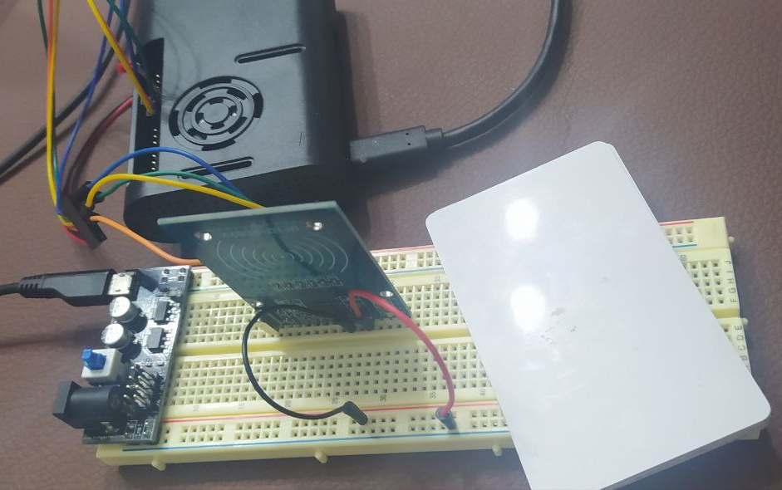
Hardware Implementation RFID
Setup for RFID testing (with Raspberry Pi 4 and RFID cards).

Slide 7
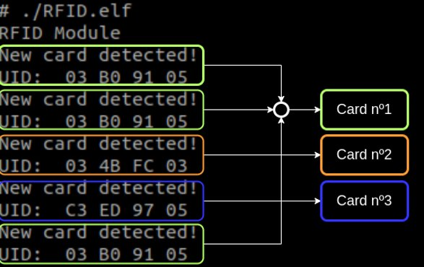
Hardware Implementation RFID
Output of detecting 3 different Cards with RFID:
Result of RFID test cases:

Slide 8
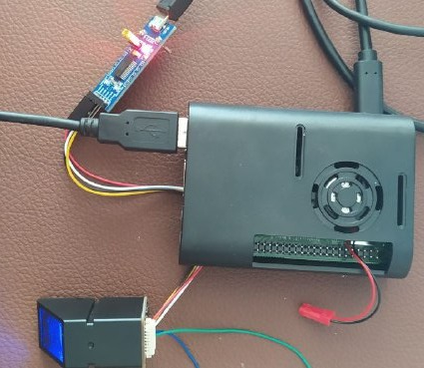
Hardware Implementation Fingerprint
Setup for Fingerprint testing:

Slide 9
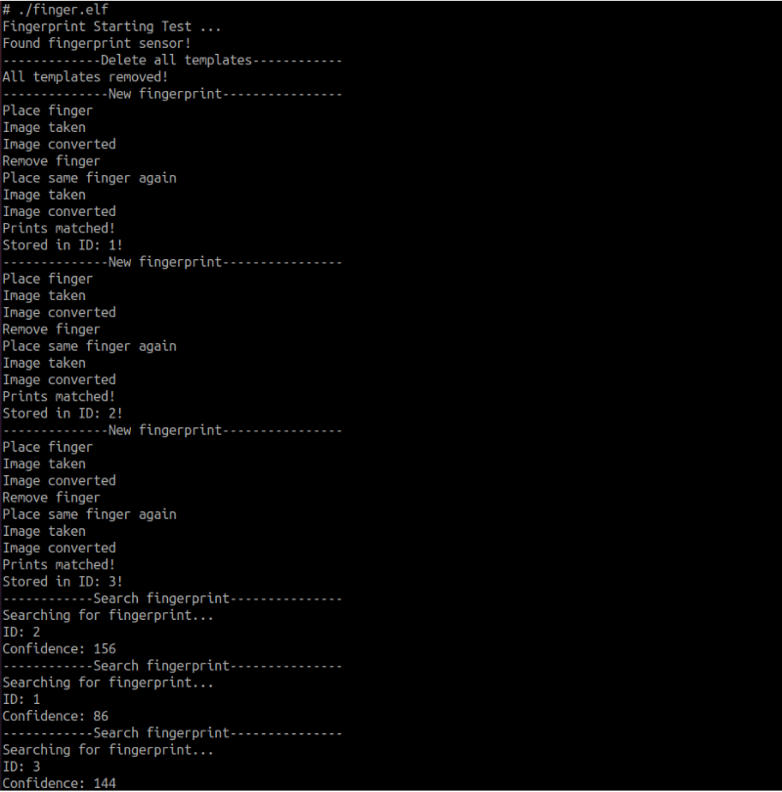
Hardware Implementation Fingerprint
Output of detecting 3 different fingers with Fingerprint reader.

Slide 10
Hardware Implementation Fingerprint
Output of detecting 3 different fingers with Fingerprint reader (continue).

Slide 11
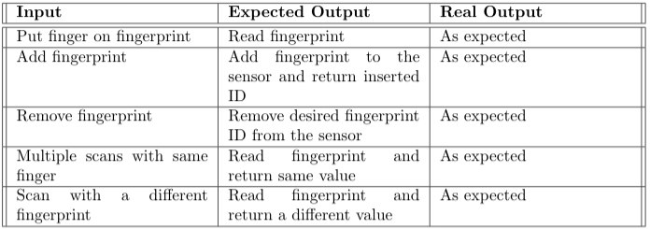
Hardware Implementation Fingerprint
Result of Fingerprint test cases:

Slide 12
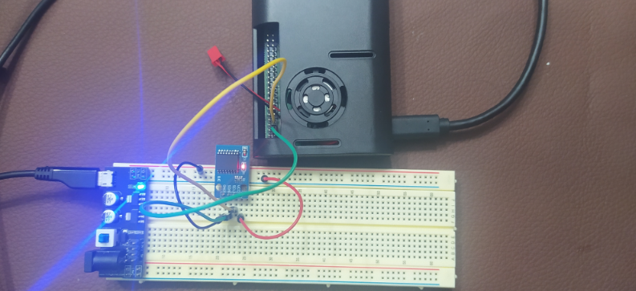
Hardware Implementation RTC
Setup for RTC testing:

Slide 13
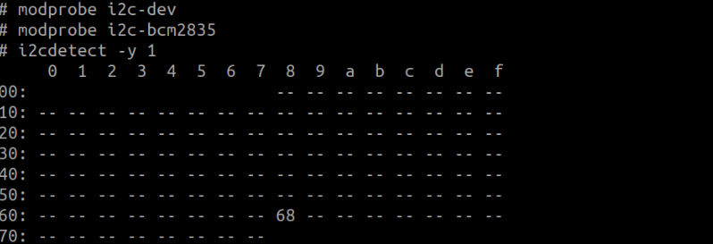
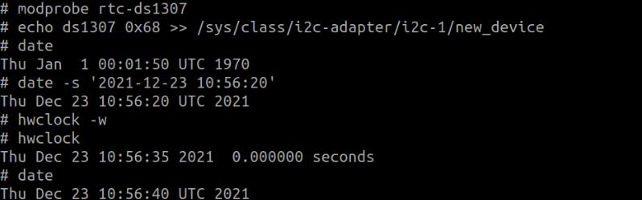
Hardware Implementation RTC
Output of the i2cdetect command.
Output of the hwclock and date commands.

Slide 14
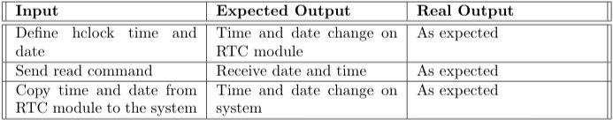
Hardware Implementation RTC
Output of the hwclock and date commands after reboot.
Result of RTC test cases:

Slide 15
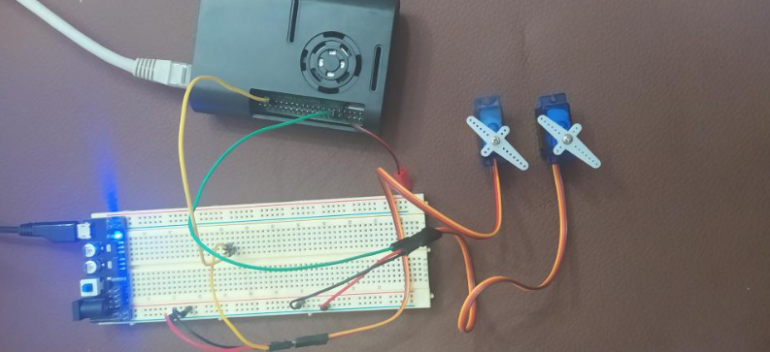
Hardware Implementation Servo Motors
Setup for Servo Motors testing:

Slide 16
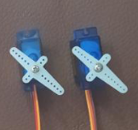
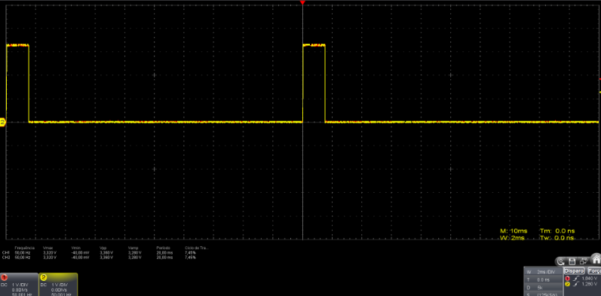
Hardware Implementation Servo Motors
PWM of each motor (Motor 1 (Duty cycle 1.5 ms) - red, Motor 2 (Duty cycle 1.5 ms) - yellow).

Slide 17
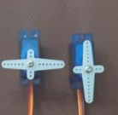
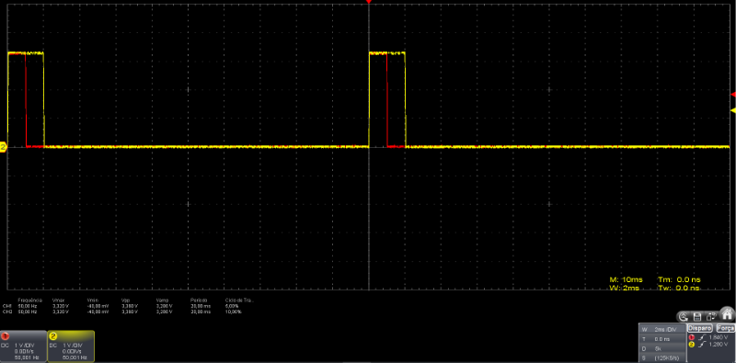
Hardware Implementation Servo Motors
PWM of each motor (Motor 1 (Duty cycle 1 ms) - red, Motor 2 (Duty cycle 2 ms) - yellow).

Slide 18
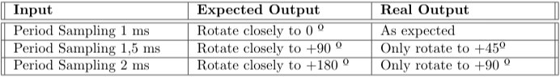
Hardware Implementation Servo Motors
Result of Servo Motors test cases:

Slide 19
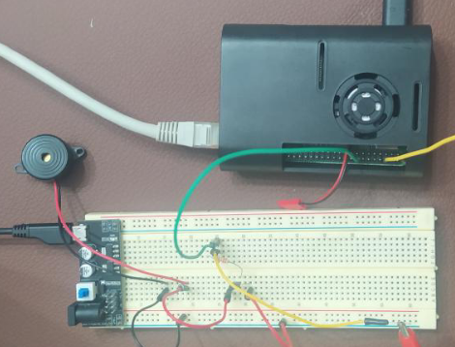
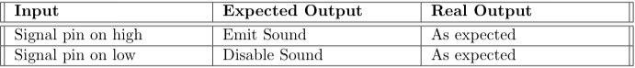
Hardware Implementation Buzzer
Setup for Buzzer testing:
Result of Buzzer test cases:

Slide 20
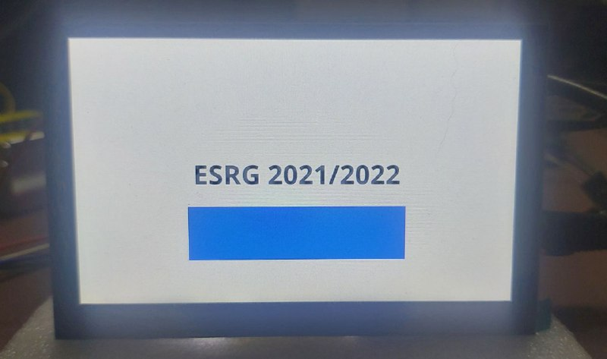
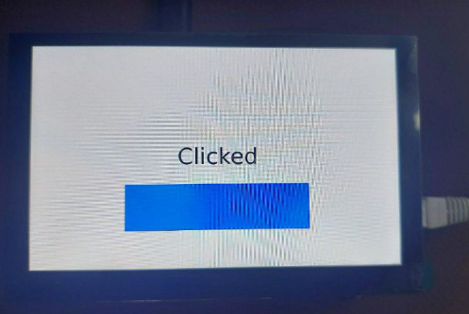
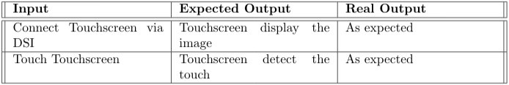
Hardware Implementation Touchscreen
Setup for Buzzer testing:
Result of Touchscreen module test cases:

Slide 21
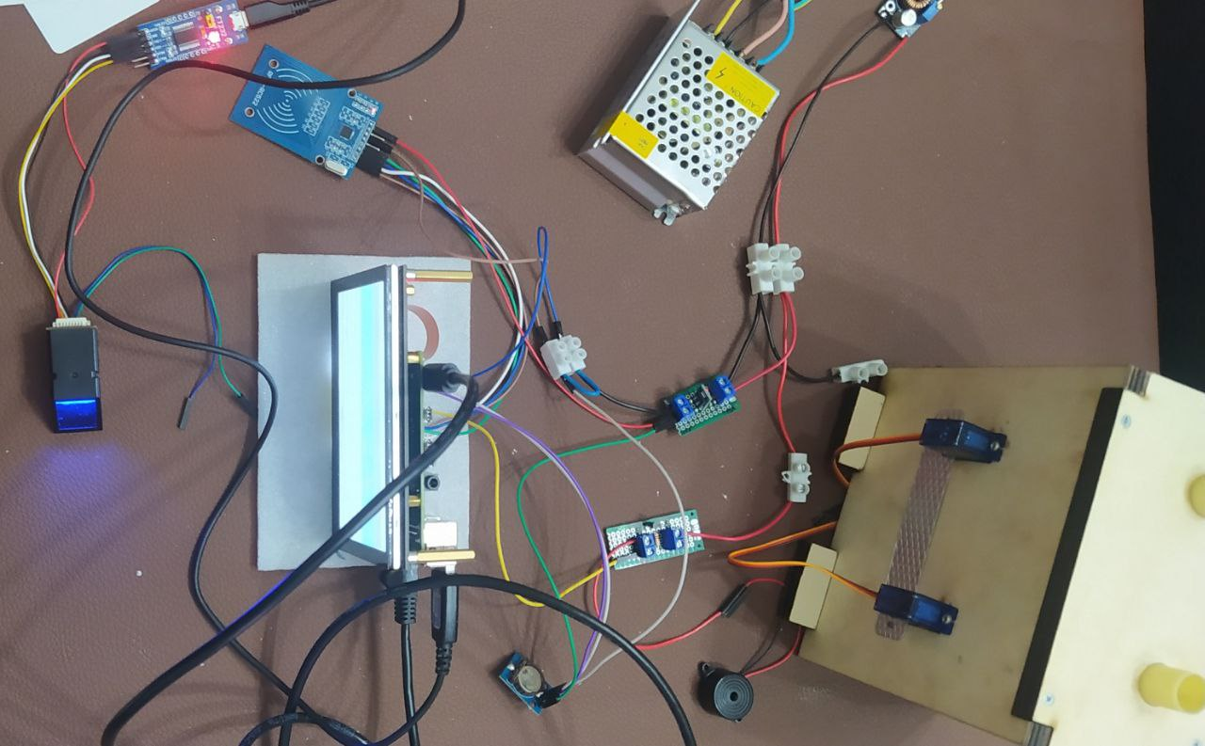
Hardware Implementation
Circuit Implementation

Slide 22
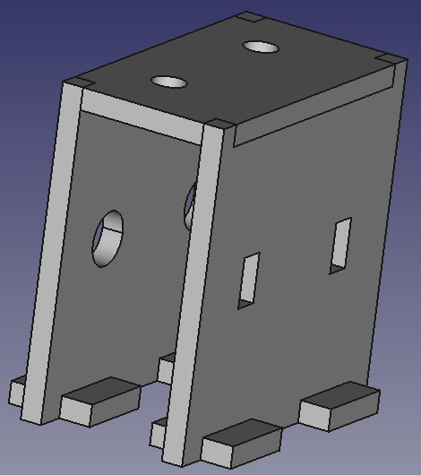
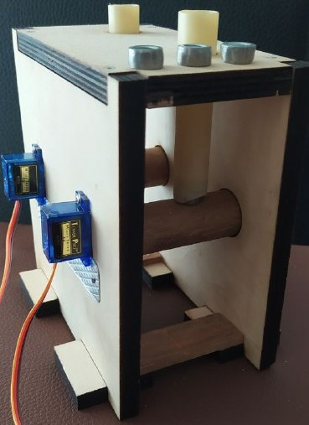
Hardware Implementation
Medicine delivery mechanism.

Slide 23
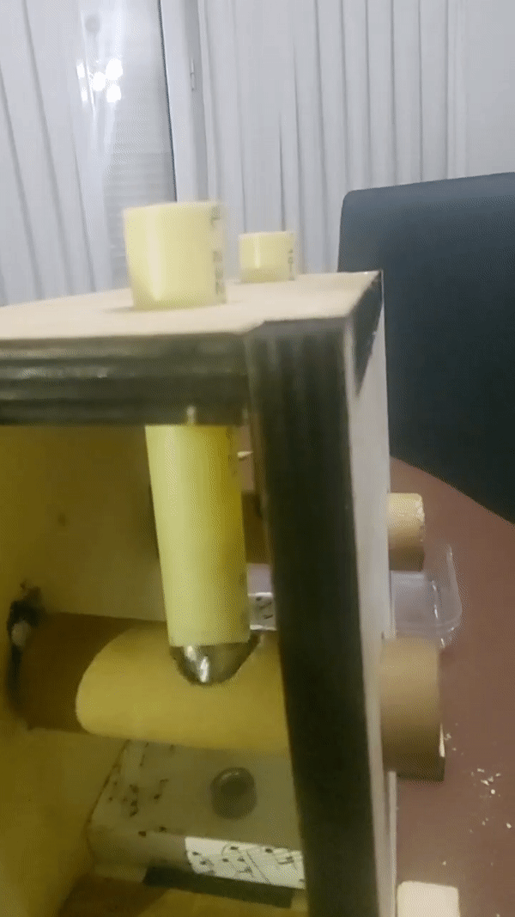
Hardware Implementation
Biggest challenges:
Build medicine delivery mechanism.

Slide 24
Software Implementation

Slide 25
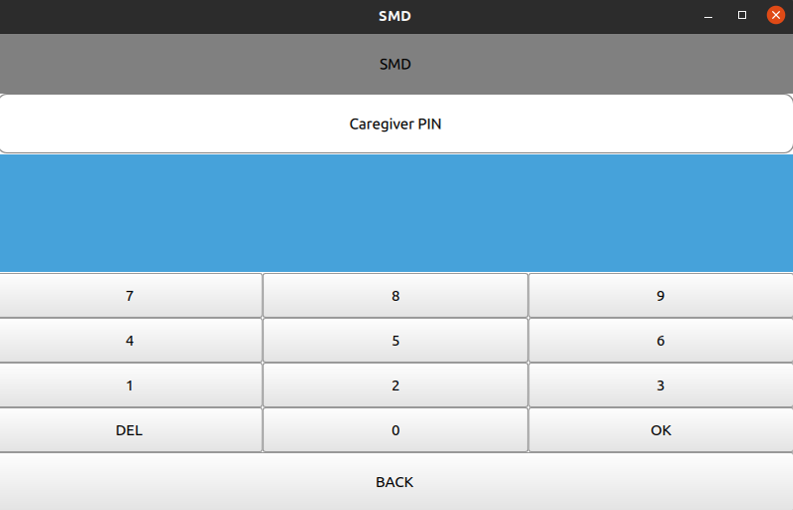
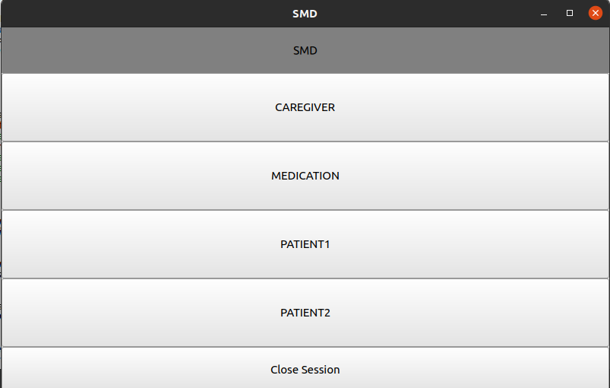
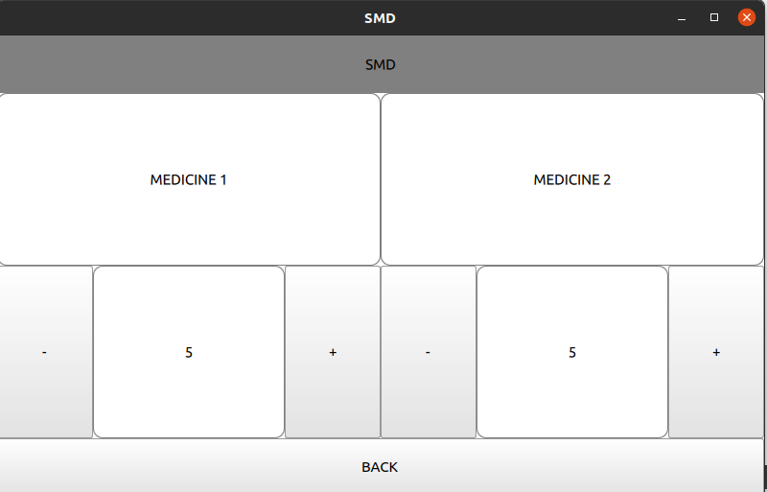
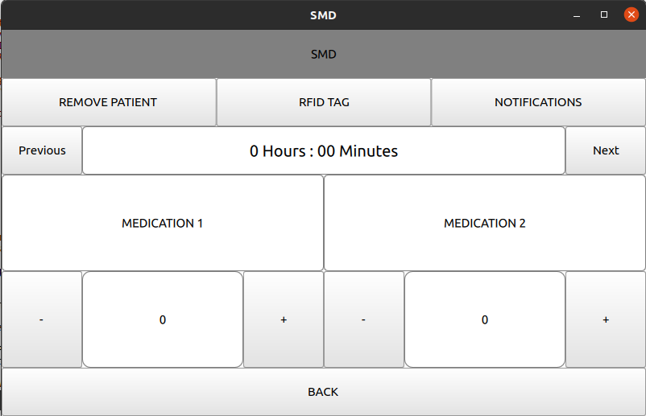
Software Implementation QML Application

Slide 26
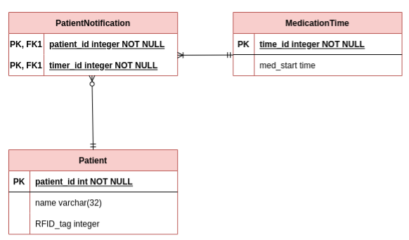
Test Cases Database
Diagram used in database testing:

Slide 27
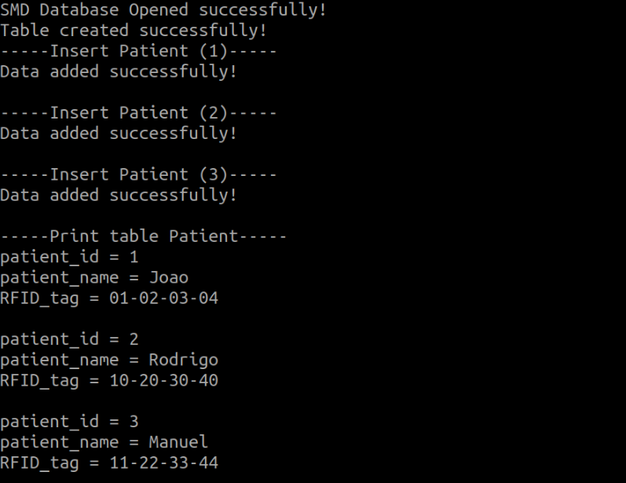
Test Cases Database
Insert three patients into the Patient table:

Slide 28
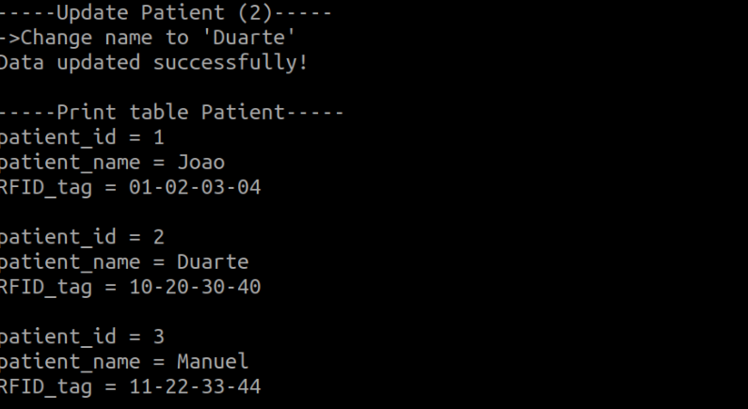
Test Cases Database
Change name of patient with id 2:

Slide 29
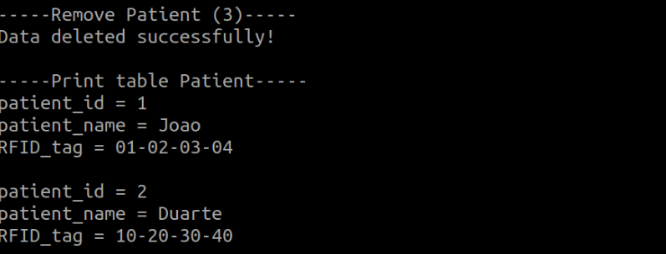
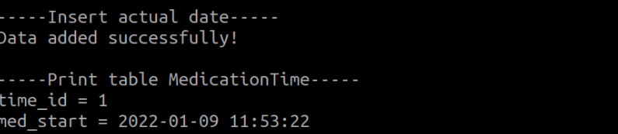
Test Cases Database
Remove patient with id 3:
Insert a date into the MedicationTime table:

Slide 30
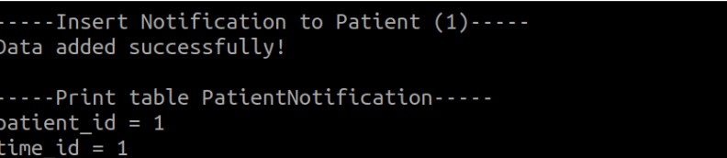
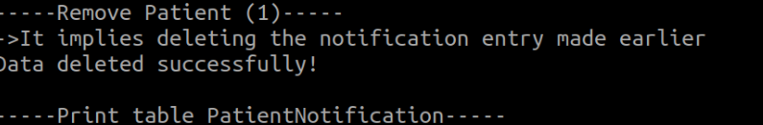
Test Cases Database
Enter a notification in the PatientNotification table for patient with id 1:
Remove patient with id 1 and check whether the removal of the patient also removed the notifications related to the patient:

Slide 31
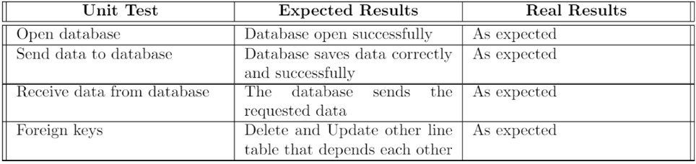
Test Cases Database
Result of Database test cases:

Slide 32
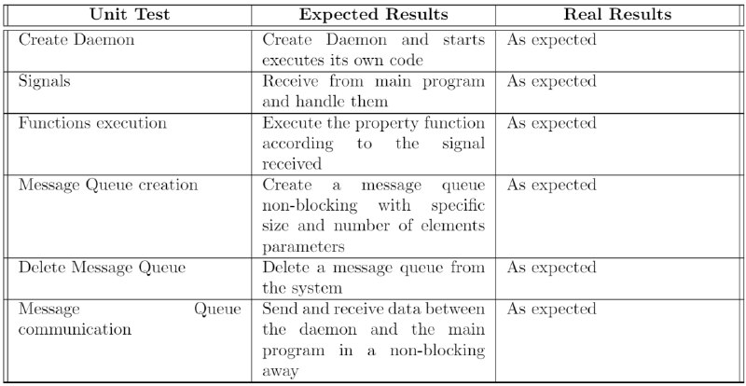
Test Cases Daemons
Result of Daemons test cases:

Slide 33
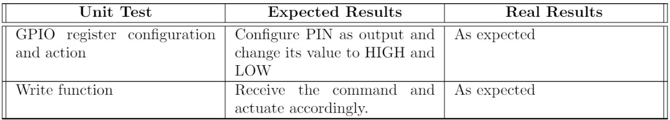
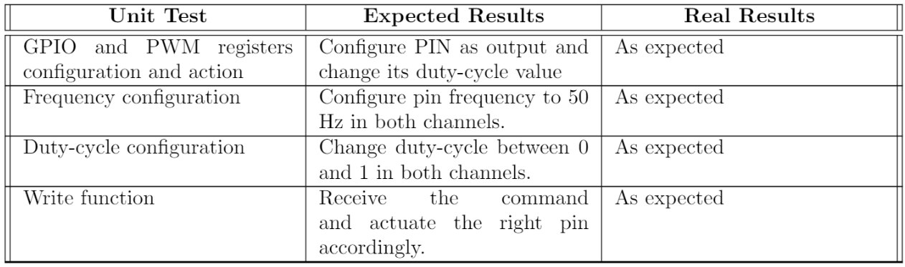
Test Cases Device Drivers
Result of Buzzer Device Drivers test cases:
Result of Servo Motors Device Drivers test cases:

Slide 34
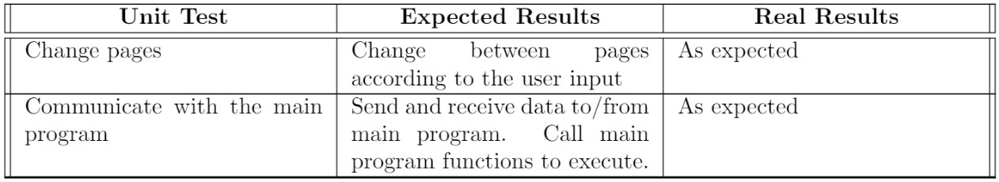
Test Cases QML
Result of QML test cases:

Slide 35
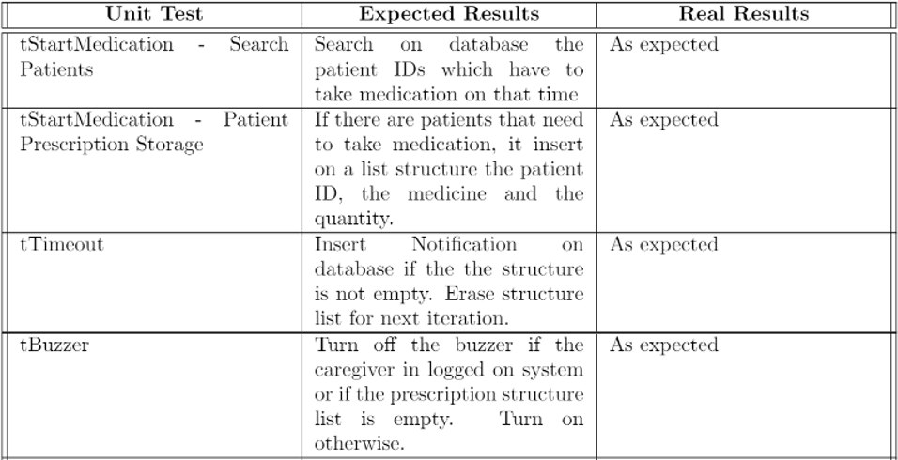
Test Cases Threads
Result of threads test cases:

Slide 36
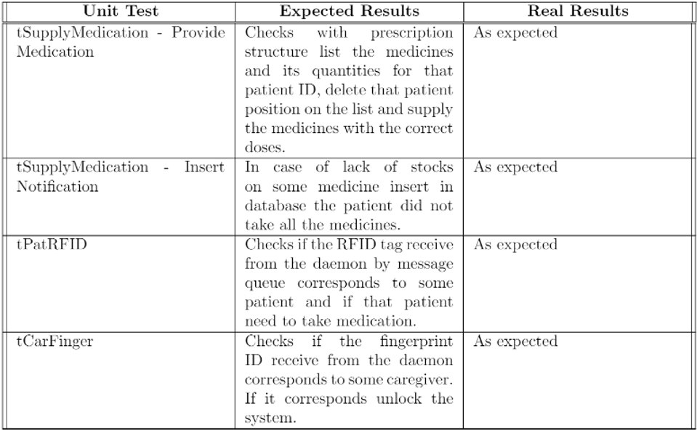
Test Cases Threads
Result of threads test cases:

Slide 37
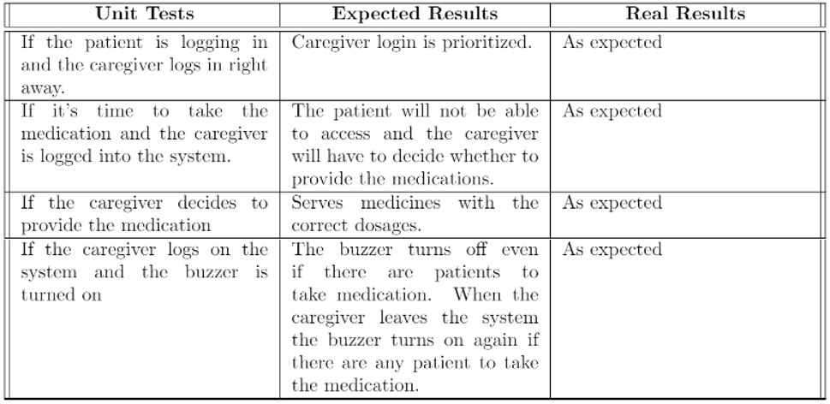
Test Cases Integration
Result of Integration test cases:

Slide 38
Software Implementation
Biggest challenges:
Run Qt programs on Raspberry pi4;
Servo Motors Device Driver;
Makefile to generate Doxygen documentation.

Slide 39
Initial Constraints

Slide 40
Constraints
Use Raspberry Pi Model 4B;
Use Embedded Linux System;
Use Buildroot for cross-platform;
Use POSIX Threads;
Implement (at least) one device driver;
Cyber Physical System (CPS);
Use Object-Oriented Programming Languages:
C;
C++.
Project deadline;
Two-member group;
Limited Budget.

Slide 41
Programmatic content accomplished
Multithreading;
Semaphores;
Condition Variables;
Mutexes;
Daemons;
RFID;
Fingerprint.
Signals;
Message Queues;
Non-blocking.
Device drivers:
Buzzer;
Servo Motors.
Makefiles;
Git - https://github.com/JoaoMiranda-88237-UM/Embebidos1SEM;
Doxygen.

Slide 42
Final Budget

Slide 43
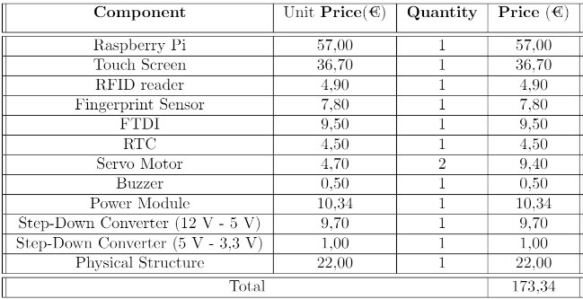
Final Budget
Estimated budget: 147,5 €
Differences:
Power Module (5,30 €);
Step-Down 5 V – 3.3 V;
Physical Structure.

Slide 44
Conclusion

Slide 45
Conclusion
SMD project provides medicine dosages at the correct times;
Prescription and medicines were managed by a responsible person (caregiver);
After that, the SMD works autonomously and notifies the caregiver:
when it’s time to take the medicines;
warning the manager about any problem:
the intake time was exceeded or the patient didn’t take the medication because lake of stock.

Slide 46
Future Work

Slide 47
Future Work
Increase number of patients and caregivers;
Build full structure;
An emitter/receiver IR sensor to detect if the system effectively dropped the medicine;
A mechanism to detect if the medicine is jammed and cut motors power supply;
Alternative login mechanism in case of RFID fails;
A GSM module to send messages informing the caregiver(s) that a patient did not take a prescription or that is a lack of stock;
A mechanism to detect the amount of medicine, or at least that the medicines are getting out of stock;
Different alerting mechanism with voice information;
Networking connection allowing the doctor/caregiver to change the prescription remotely.

Slide 48
Improvements to Project Management

Slide 49
Improvements to Project Management
Problem Statement:
Spent more time looking for solutions instead of problems;
Analysis:
Further study of use cases;
More detailed Gantt diagram with better defined deadlines;
Design:
Further study of some previously unused tools;

Slide 50
Questions ?

